Slide 1
Azure Sentinel - Deployment, Detection & Response
Ali Ahmed Dar

Slide 2
Demo Details
Create a personal Azure account
Make a Resource Group
Add a Sentinel instance to that RG
Integrate your host's logs to that Sentinel
Make an Automation on Sentinel that will automatically remove a malware if it triggers one of your Analytic rules

Slide 3
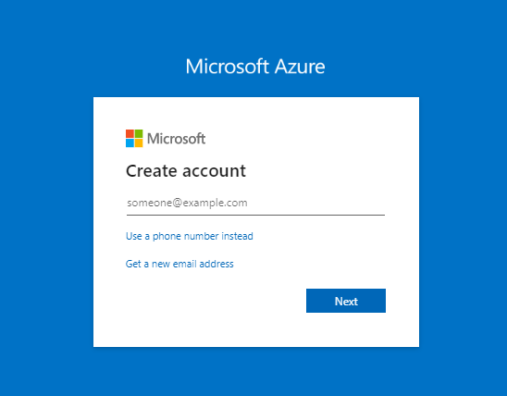
1. Azure Account
Head up to https://portal.azure.com and create an account (if not already)

Slide 4
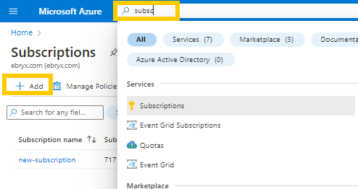
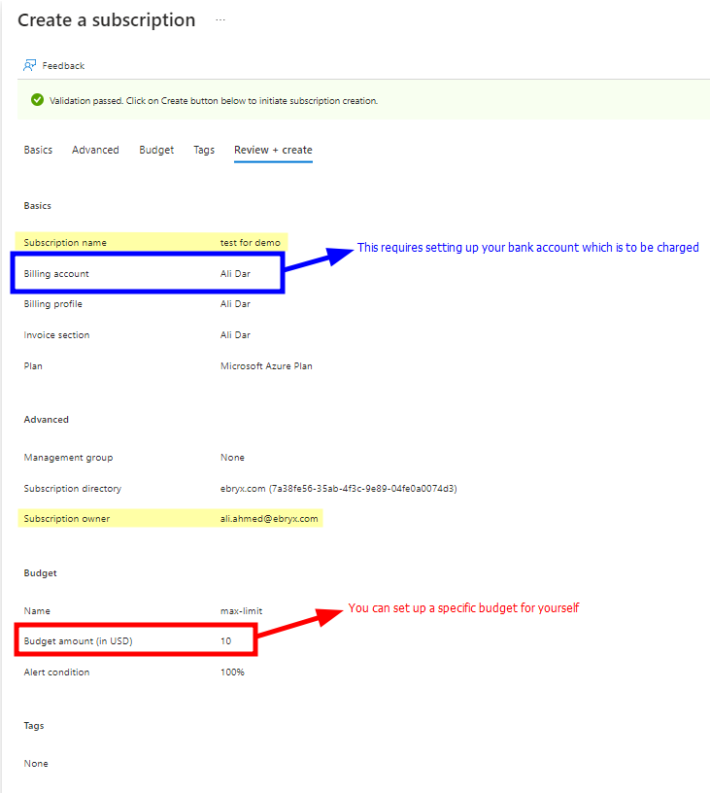
2. Subscription
First of all, you will need an azure subscription under which you will be setting up all your resources.
(They do offer a free trial and some free dollars for a limited period of time, so avail that for learning and testing stuff)

Slide 5
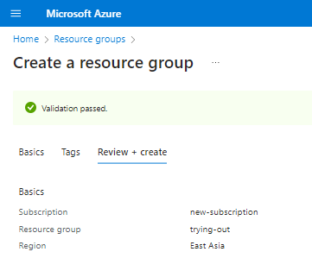
3. Resource Group
Now the first real environment/tool we will create is a resource group, which is a container that holds related resources for an Azure solution.
This basically requires very little information
The subscription (that we already created)
The name for the resource group (as per your choice)
The geographical region (select from the list as per the requirement)

Slide 6
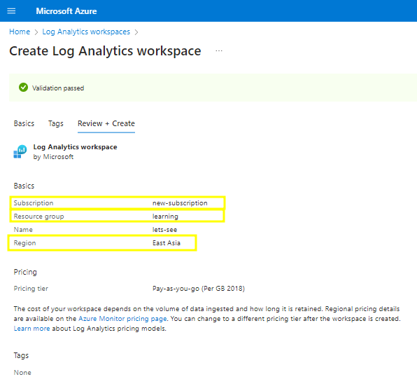
4. Log Analytics Workspace
The next step is to create a workspace in which we will be deploying out sentinel.
This step also requires information about the resources which are above in the hierarchy.

Slide 7
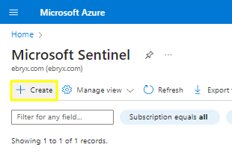
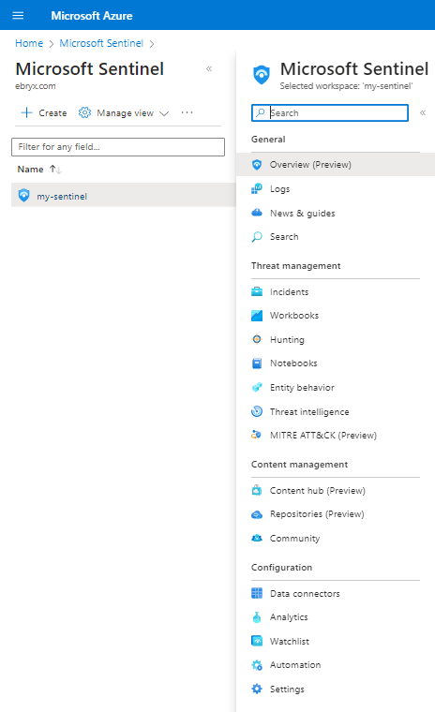
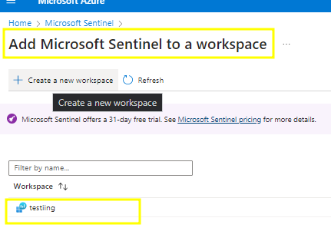
5. Deploy Sentinel
The next step is to deploy sentinel in the log analytics workspace that you have created.
And you'll have your sentinel solution up & running in a few seconds.

Slide 8
6. Log Ingestion

Slide 9
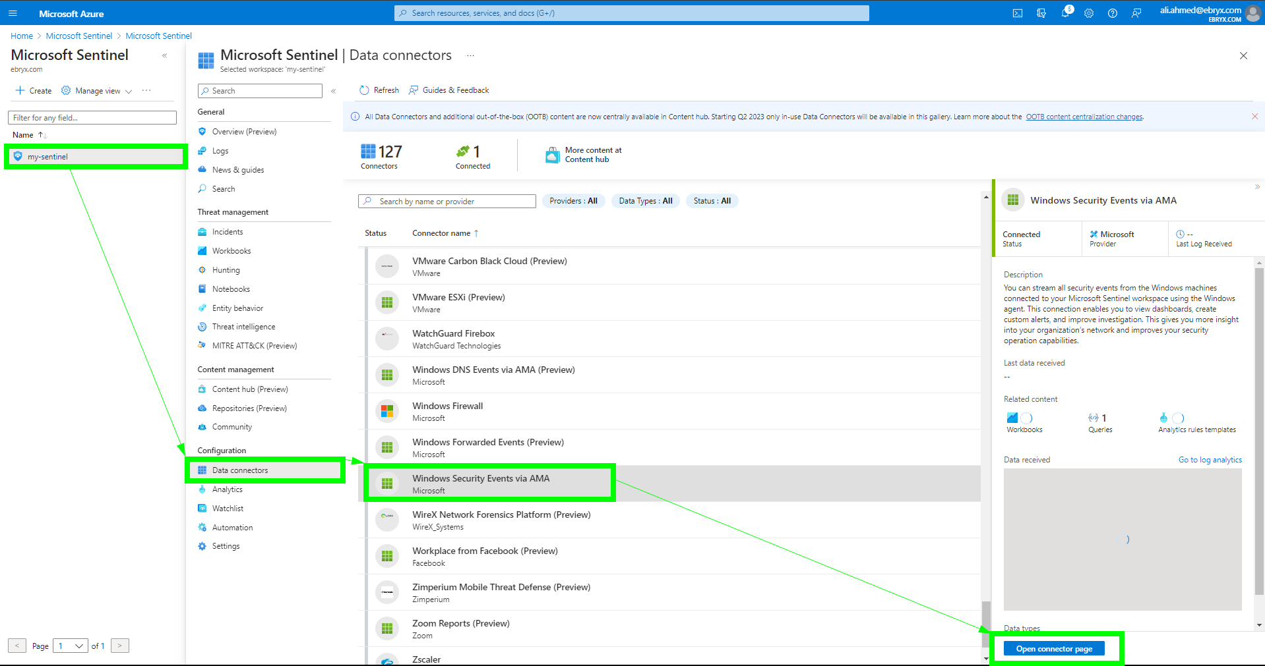
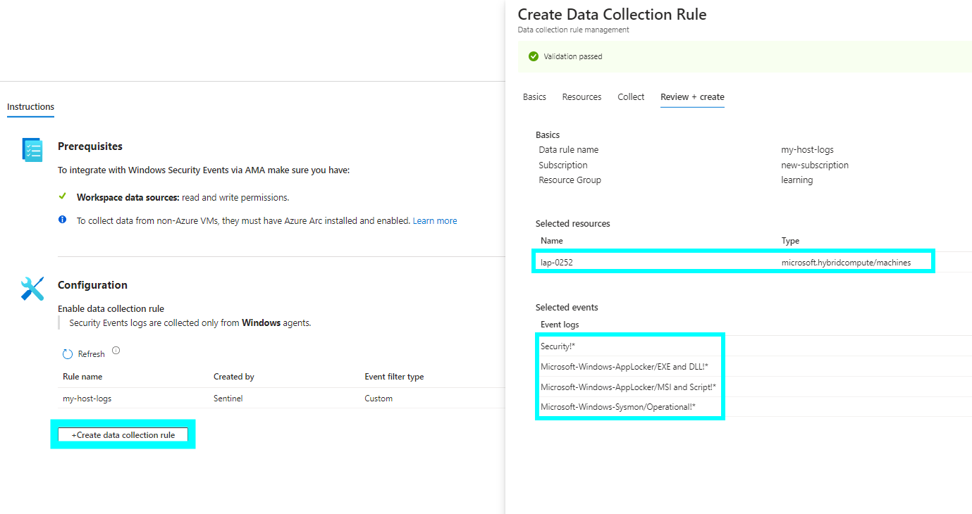
6.1 Connectors
In the left pane in sentinel, you can see a Connectors tab, which you can use to start ingesting your data into Microsoft Sentinel.
From among the several types, we will select Microsoft Windows Connector for this demo and enable it.

Slide 10
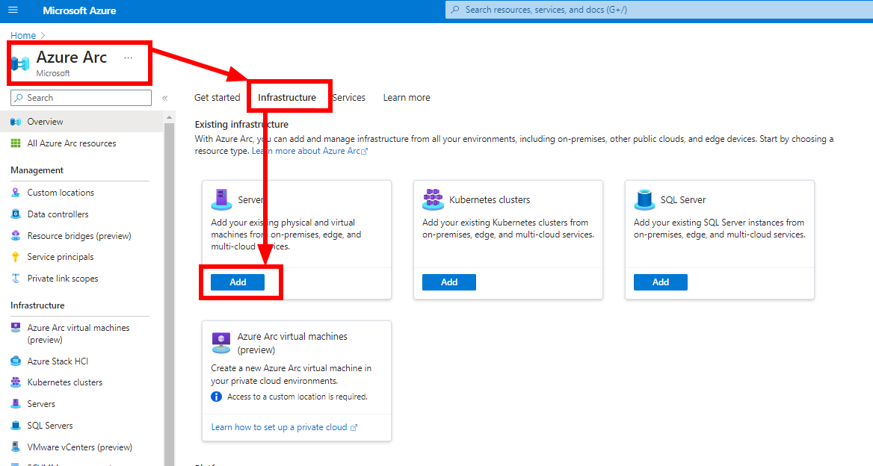
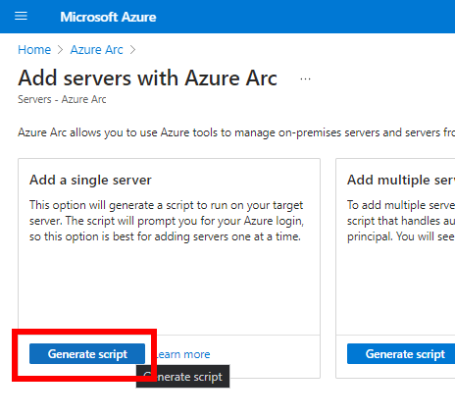
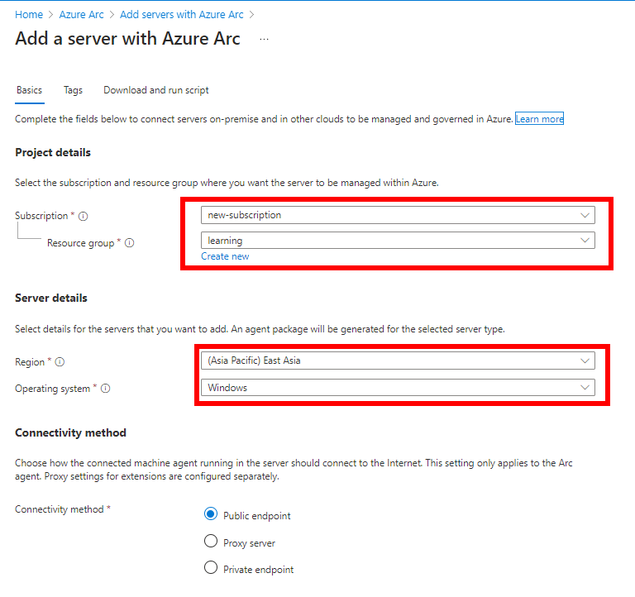
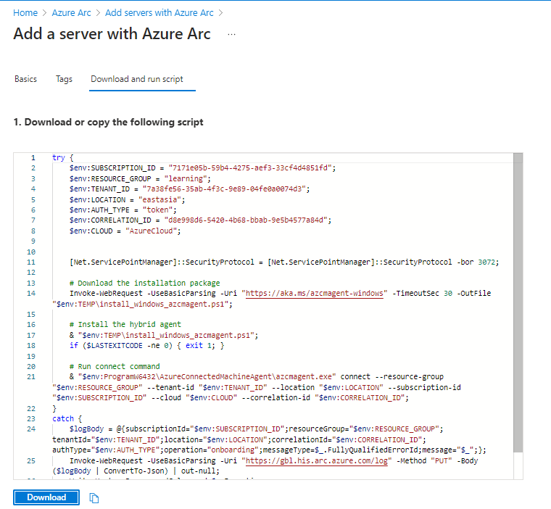
6.2 AMA
For this demo, I am using my Windows Host, which needs to have Azure ARC agent installed. This will be done by installing an agent on your windows host with the help of the script generated in Azure ARC onboarding.

Slide 11
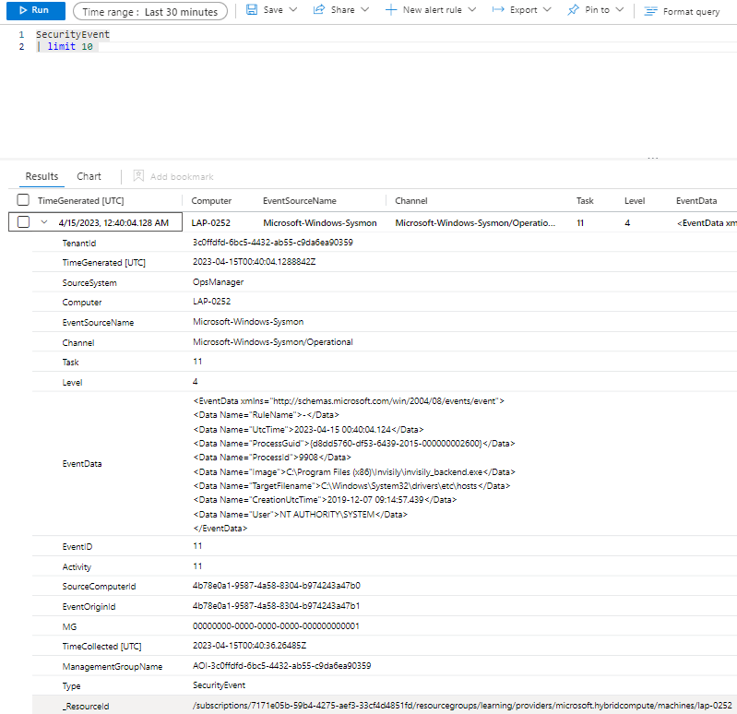
6.3 Verify logs
You may to go to logs view to verify log ingestion.

Slide 12
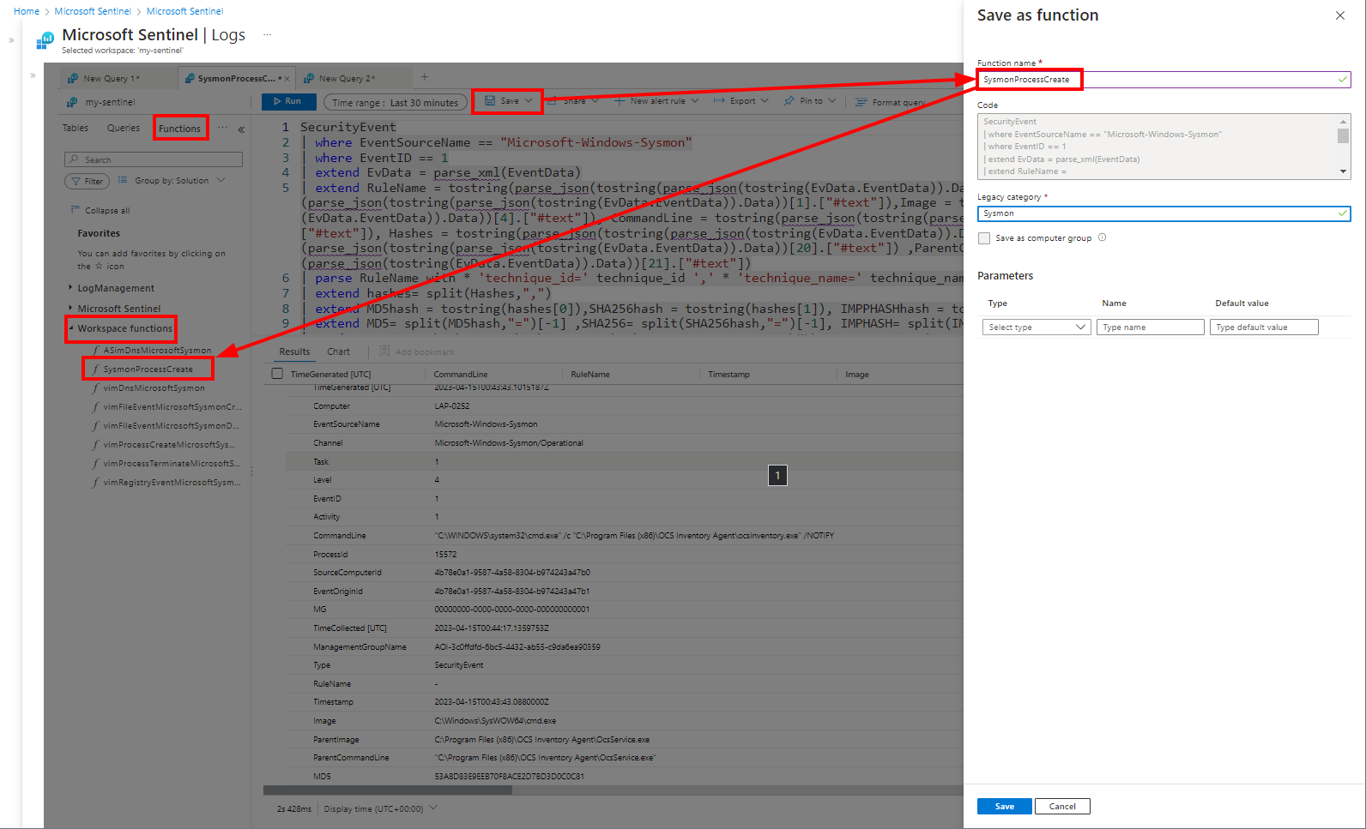
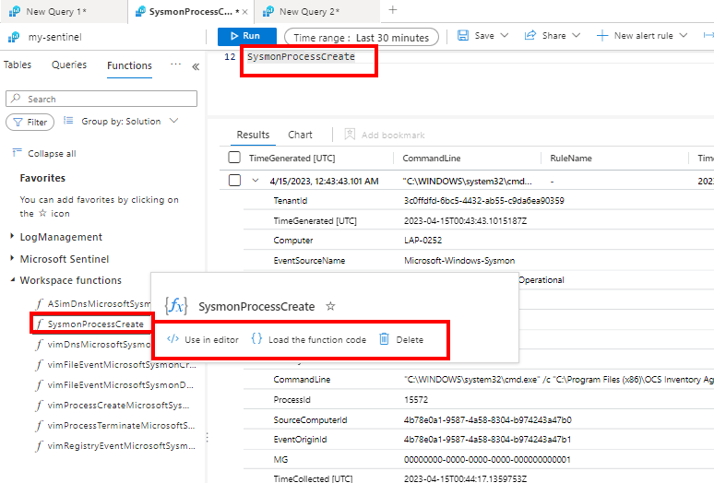
6.4 Log Parsing
But the logs need to be parsed using ASIM parsers, I have written my own for ProcessCreation event currently, which you can save as function and call as a separate table

Slide 13
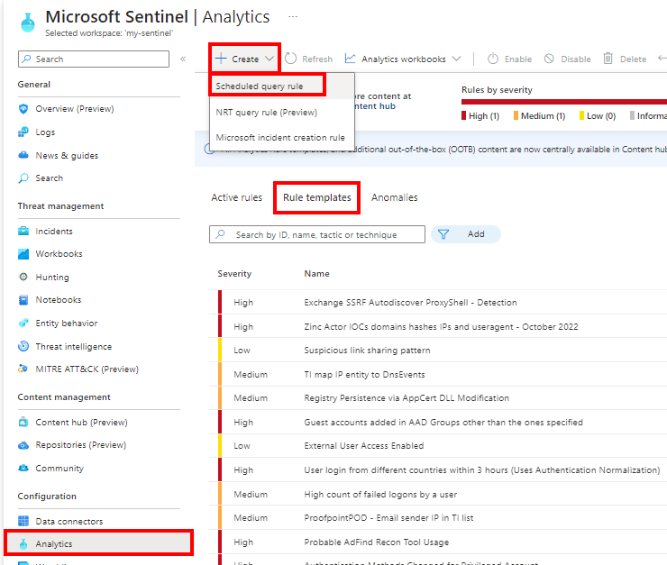
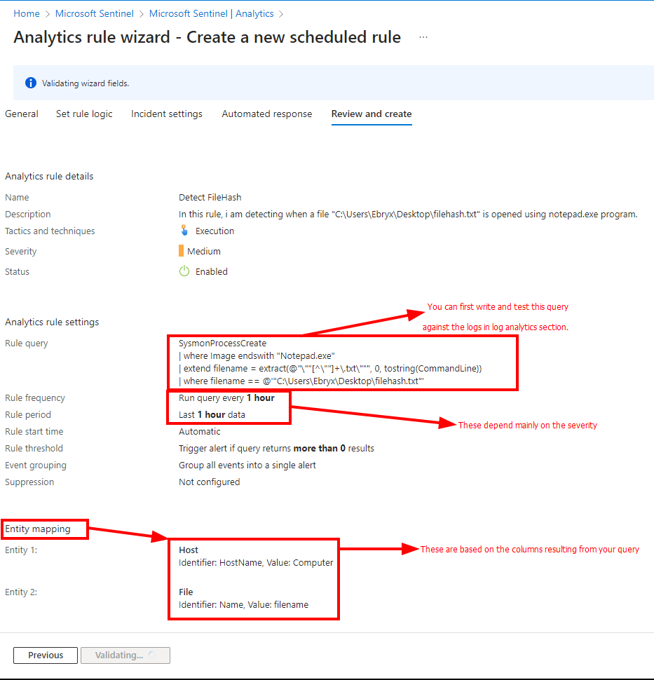
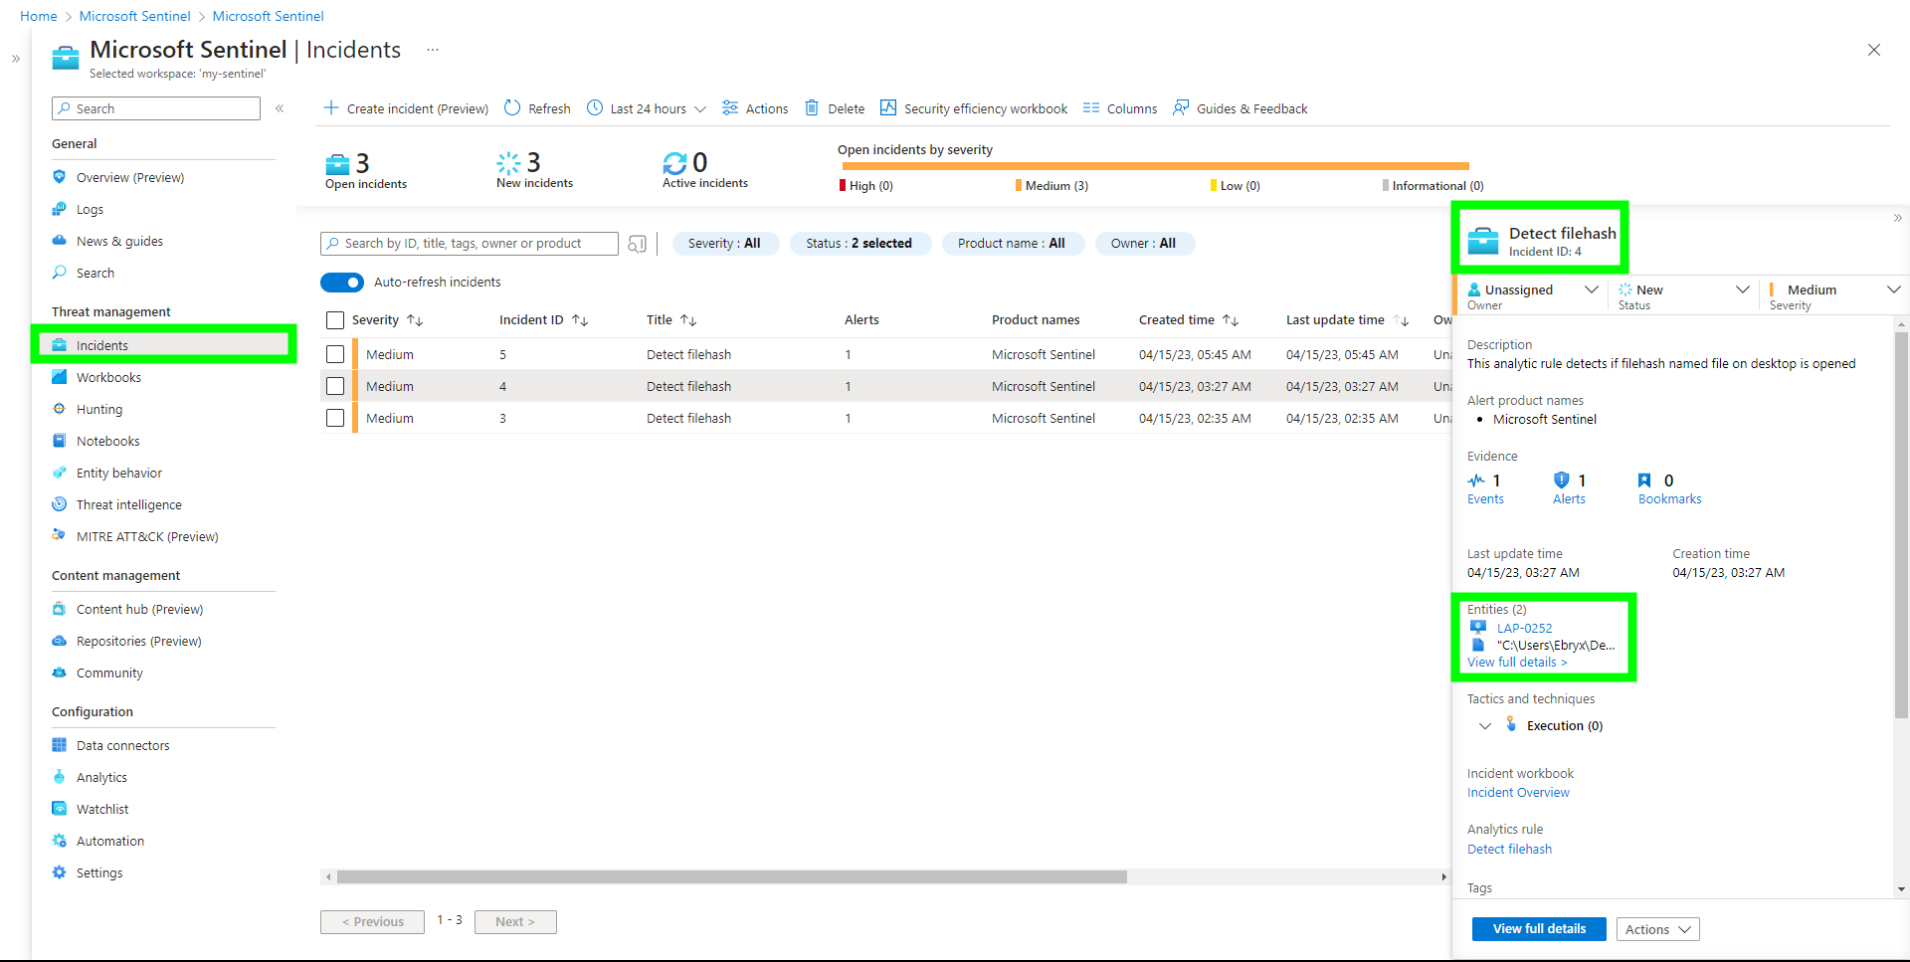
7. Detection
Now that we are receiving logs, we can create custom detection rules along with built-in rules on top of this through Sentinel Analytics Rules which are based on KQL - Kusto Query Language.

Slide 14
8. Automated Response

Slide 15
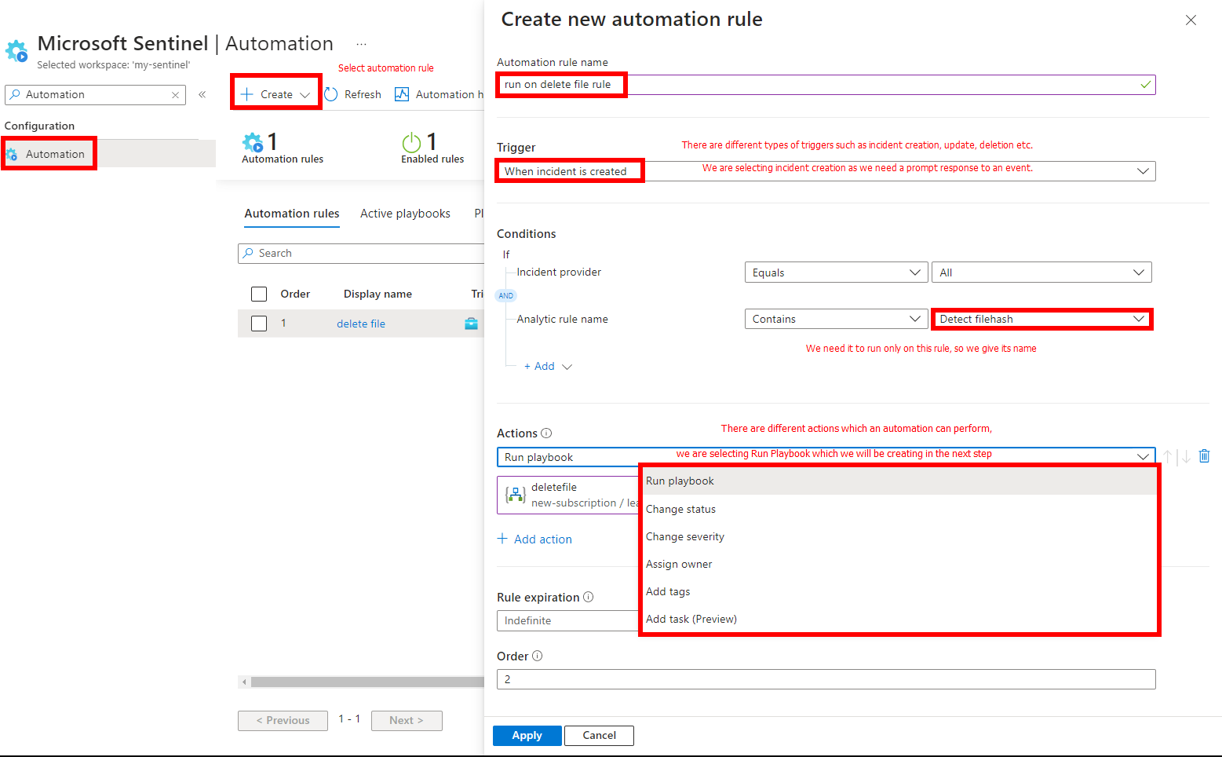
8.1 Automation Rule
First of all we will create an automation rule, which will trigger upon creation of an incident.
This automation will call the playbook that we will be creating next.

Slide 16
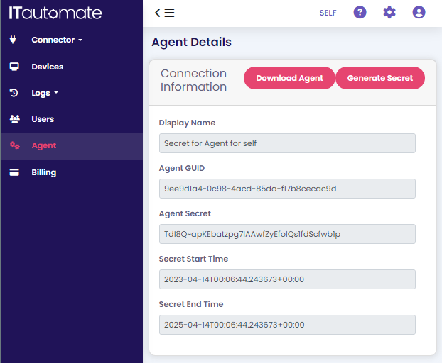
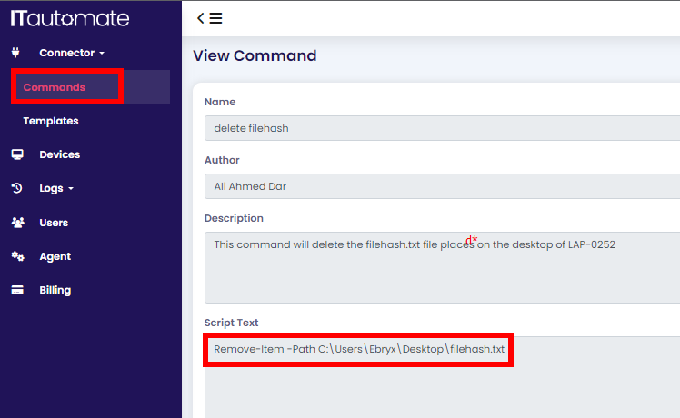
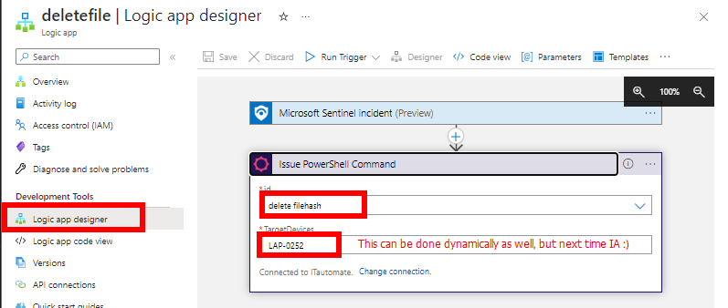
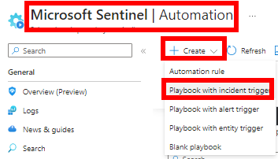
8.2 Playbook
Due to restricted EDR tendencies and unavailability of Defender, I used the 3rd party integration ITAutomate.
You need to configure the agent just like we do for any remote control tools.
Create a script that will be executed on the Target Host
Pass the name of the script and the target host to the logic app

Slide 17
Demo Video Link
Azure Sentinel - Demo - AliAhmedDar.mp4
References
Azure Portal
Azure Regions
Azure Resource Group - Microsoft Learn
Azure Log Analytics Workspace - Microsoft Learn
Azure Sentinel Windows Data Connector - Microsoft Learn
Azure Sentinel Data Normalization with ASIM Parsers - Microsoft Learn
Kusto Query Language (KQL) - Microsoft Learn
Azure Sentinel Built-in Threat Detections - Microsoft Learn
Azure Sentinel Custom Threat Detections - Microsoft Learn
Azure Sentinel Automation Rules - Microsoft Learn
Azure Sentinel Playbooks - Microsoft Learn
Azure Sentinel Playbooks Repo - Github

